Slide 1
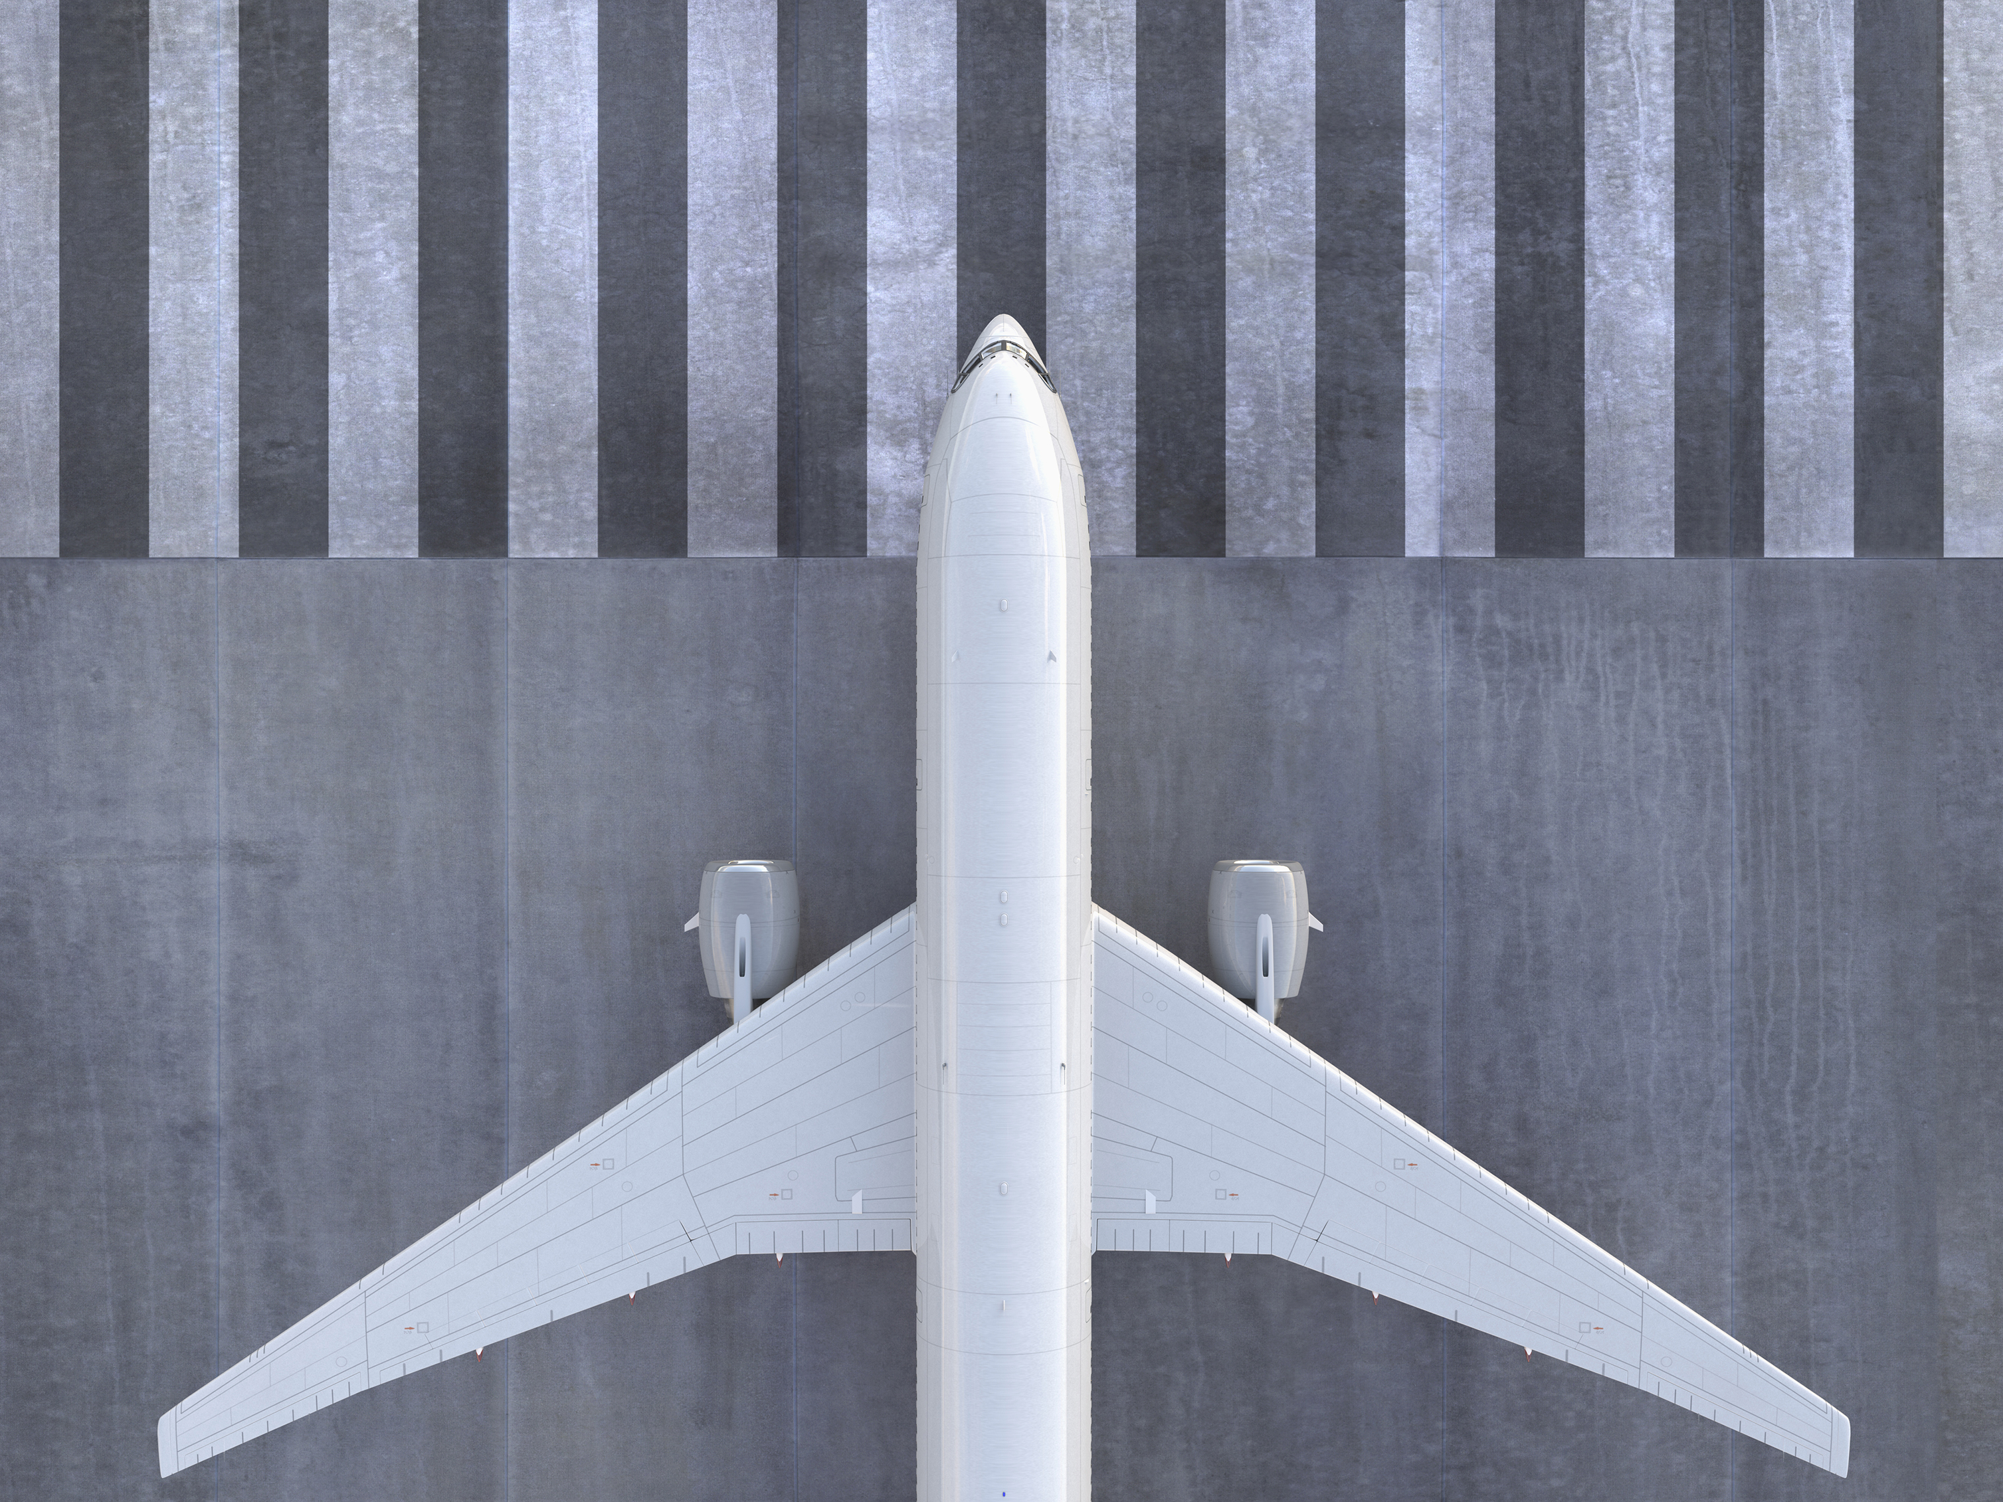

Inspiring Passenger Confidence: Airline Safety in Fatalities and Incidents
Created by: Aarti Ramani
Created on: 8/11/2023
Notes:
Greetings to all adventurous travelers seeking new horizons and global treasures.
In an era of groundbreaking aviation advancements, where exploration knows no bounds, a crucial question arises:
How secure is air travel that takes us across the world?

Slide 2

Introduction
We're in an era where air travel innovations have unlocked unprecedented global exploration. Amid our excitement, a question lingers: How safe is air travel, really?
Let’s take a statistical journey through safety data from 1985 to 2014 as we uncover the truth about flight safety.
Notes:
In a world filled with constant news updates, airline incidents are no strangers. These unsettling stories can create doubts even in the most fearless travelers.
Let’s take a statistical journey that will navigate through decades of airline safety data, spanning from 1985 to 2014, uncovering the truth about flight safety.
We’ll now shift our focus to carrier performance, which paints a comprehensive picture of safety across different airlines.
NEXT SLIDE

Slide 3
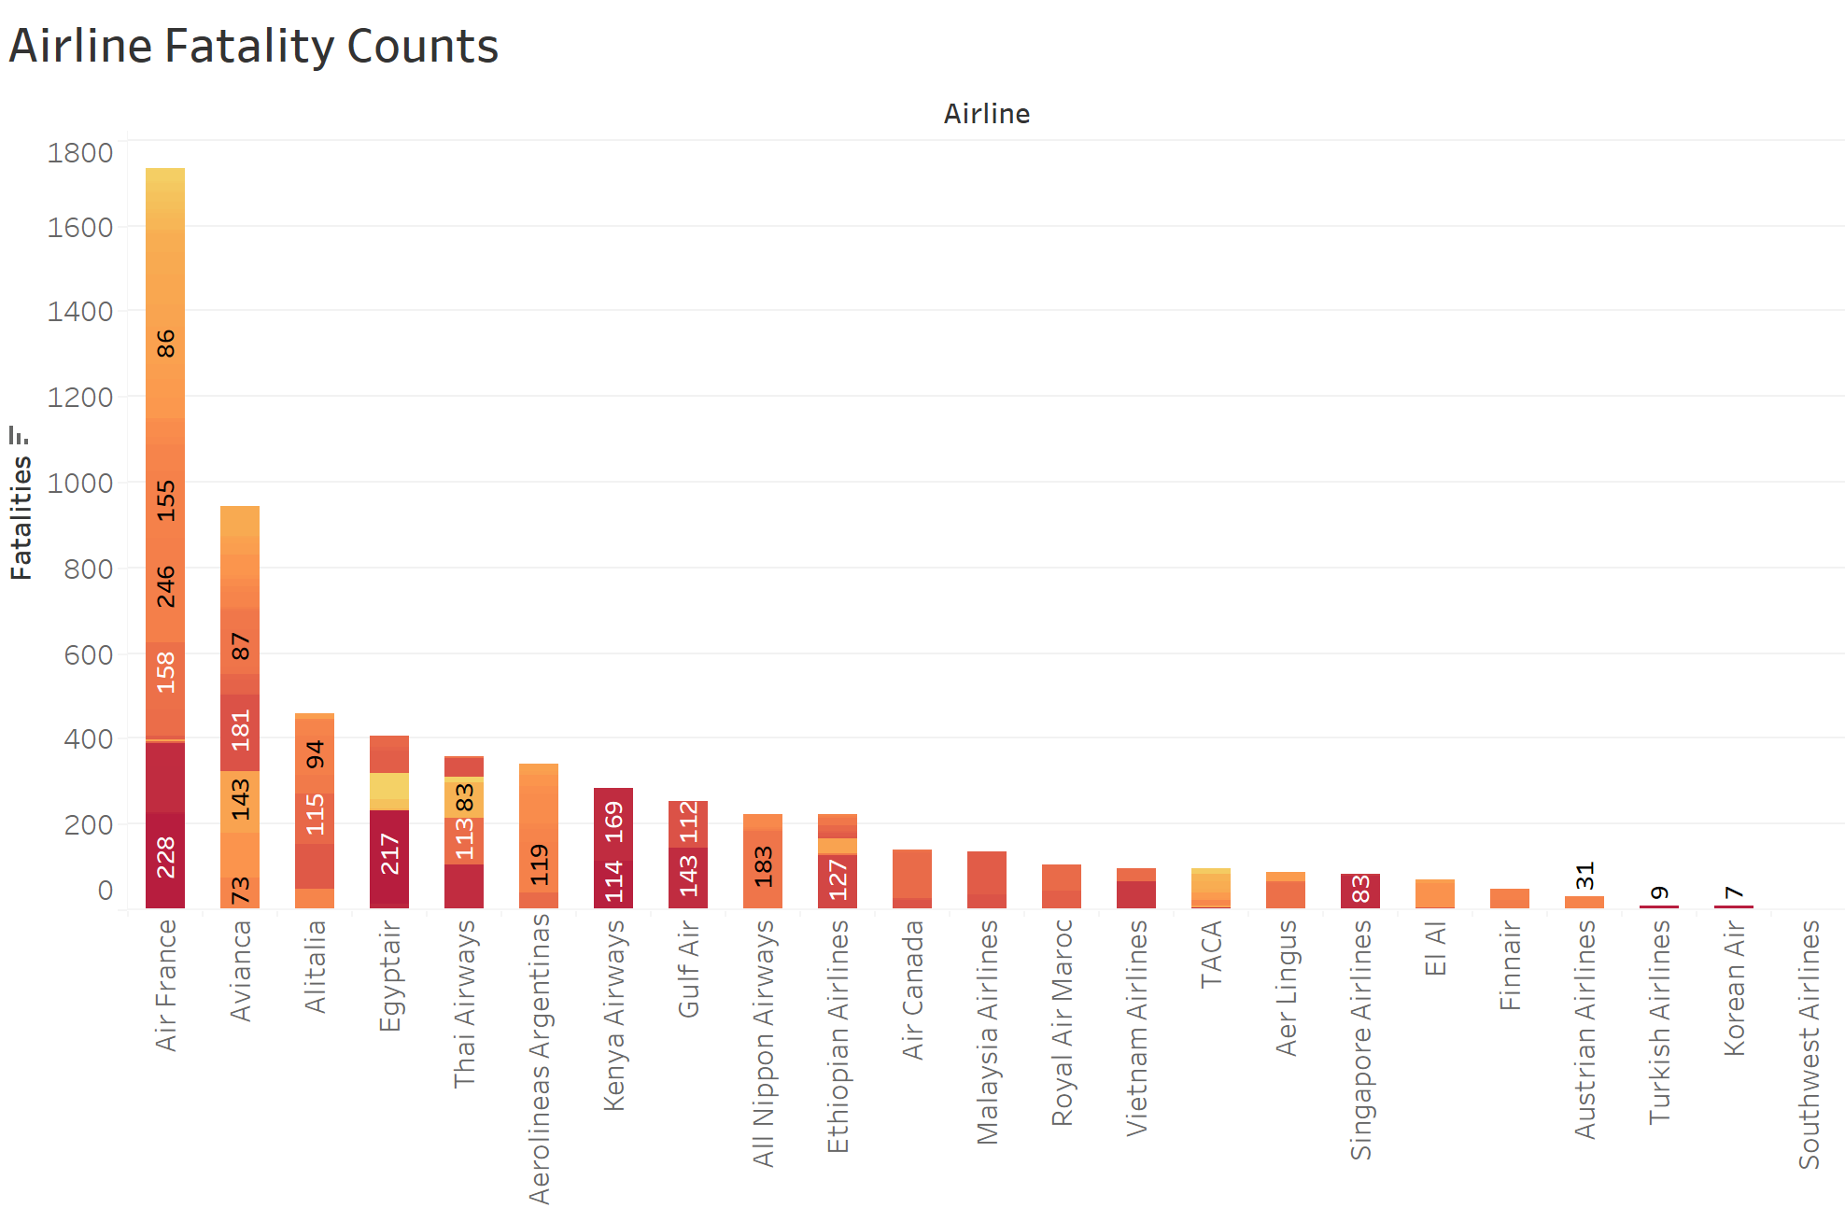

Exposing the Best and Worst Carriers
Notes:
Confirming airline safety before booking brings peace of mind. This chart highlights top and low-performing airlines, empowering informed travel choices.
As we continue our journey to grasp airline safety, we can't ignore a crucial element: the aircraft itself. The next slide examines various aircraft types, spanning safety spectrums from best to least commendable.
NEXT SLIDE

Slide 4
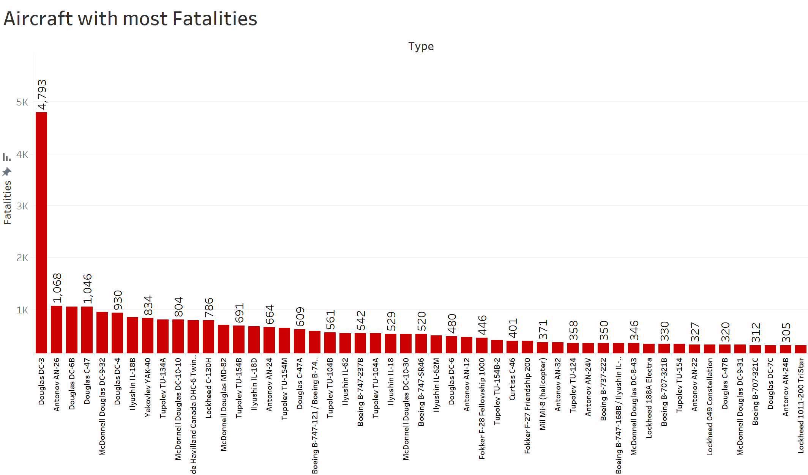

The Role of Aircraft in Ensuring Airline Safety
Notes:
While passengers might not always choose their aircraft, having that option could enhance safety. For instance, the Douglas DC-3 aircraft has had the highest recorded fatalities. This detail could be vital for passengers to know before booking, allowing them to prioritize safety preferences.
Moving ahead, the journey takes us to a visual representation that paints a global picture of airline safety.
NEXT SLIDE

Slide 5
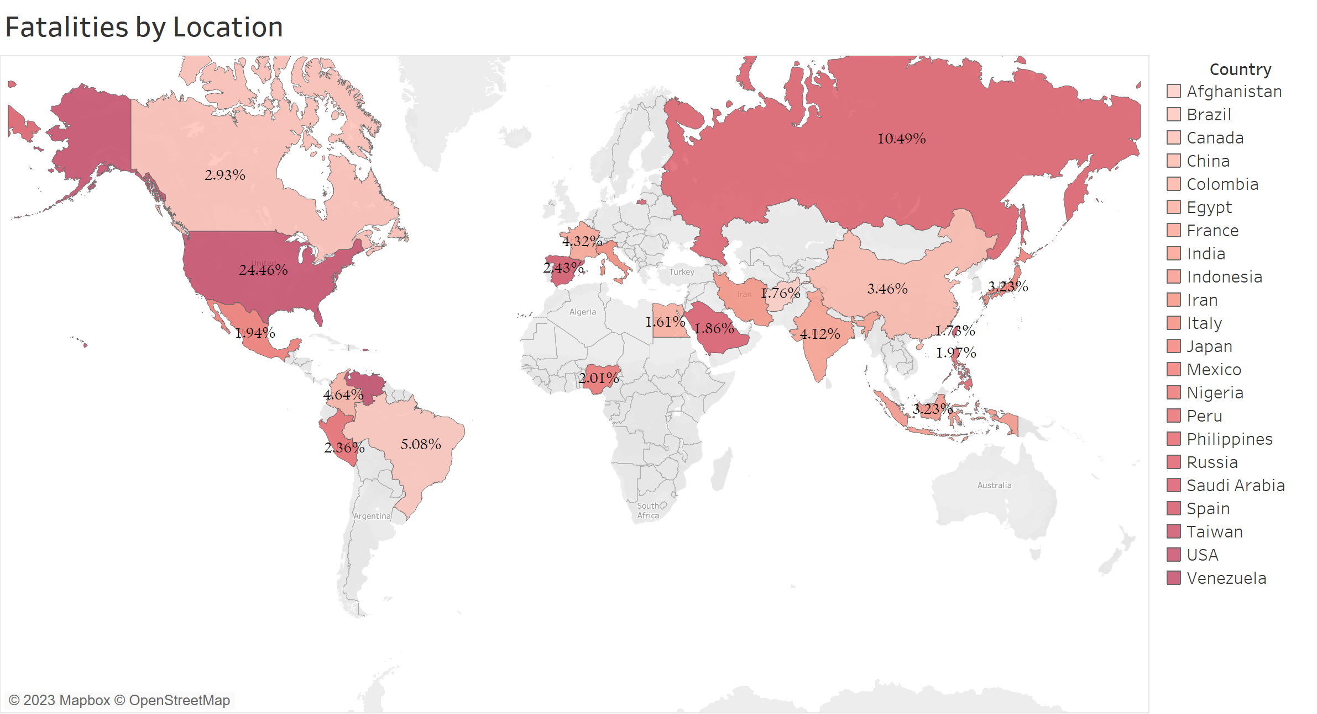

Country-wise Fatality Rates
Notes:
The visual representation illustrates the fatality rate categorized by country. The intention behind sharing this chart is to provide passengers with a clear understanding of safe travel destinations.
Our expedition now turns towards uncovering the dynamic trends that have shaped the course of airline fatalities.
NEXT SLIDE

Slide 6
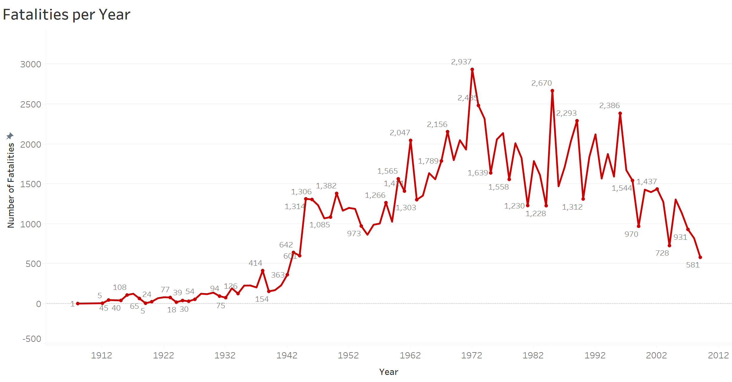

The Road to Safer Skies: Examining Air Travel's Past and Future
Notes:
Historical data shows a spike in fatalities between the 1970s-80s followed by a consistent decline. Airlines prioritize passenger safety with unwavering commitment and advancements. As passengers, we find solace in maintained safety standards, ensuring our travels are secure.
As we step into the concluding slide, let's gather our insights and observations to craft a holistic understanding.
NEXT SLIDE

Slide 7

Conclusion
So, Is air travel safe?
In conclusion, absolutely. Air travel ranks among the safest transportation methods available today. Rest easy knowing the chances of a fatal airline accident are incredibly slim – just one in a million. Feel confident as you take to the skies for your adventures, benefiting from air travel's unmatched safety and security.
Notes:
Flying is statistically safe, with reducing fatalities over time. While no travel is risk-free, rest assured, passenger safety is unwavering. As you journey, countless experts strive for your safe arrival. Embrace the skies with confidence, as your safety is the utmost priority in every flight.

Slide 8

THANK YOU!
Notes:
Thank you for your time. Safe travels, and may your journeys always be marked by security, discovery, and inspiration.

Slide 9
References
Airplane crashes 1908-2009 - dataset by hhaveliw. data.world. (2018, July 12). https://data.world/hhaveliw/airplane-crashes-1908-2009
Fivethirtyeight. (n.d.). Data/airline-safety at master · fivethirtyeight/data. GitHub. https://github.com/fivethirtyeight/data/tree/master/airline-safety

